Slide 1
BIKE RENTAL DATA ANALYSIS
Automated Dashboard, Forecasting & Data Insights
Project Presentation
Project given by:- Nexthikes IT Solutions
Submitted by:- Shubham Tiwari

Slide 2
Introduction
* In this rental bike sharing data project we analyse the bike rental data to understand rental patterns, customer behaviour and the impact of weather condition like temperature, windspeed & humidity.
* This project have hourly bike rental data from 1 January to 14 February, covering rental demand.
* In this data we understand pattern of rental bike through every condition which is given in this data set.

Slide 3
Project Objectives
* Firstly Analyse the bike sharing demand through excel based data analyses and statistical function.
* Start data preprocessing and clean, classify and transform the dataset using formulas & structured values.
* Analyse demand by date, time, day, holiday, weather situation, windspeed, temperature, humidity with the help of pivot tables
* Create a dynamic interactive dashboard through some pivot charts, waterfall charts, pie charts & timeline slicers.
* Apply anomaly detection and forecasting to generate decisions.

Slide 4
Dataset Overview
Dataset_1
Date, Hour, Holiday, Weekday, Weather, temperature
Dataset_2
Humidity, Windspeed, Casual, Registered, Count
Dataset_3
Add some other customer records
Dataset A
Dataset_(1+2)
Final Dataset
1000 Records of rental bike

Slide 5
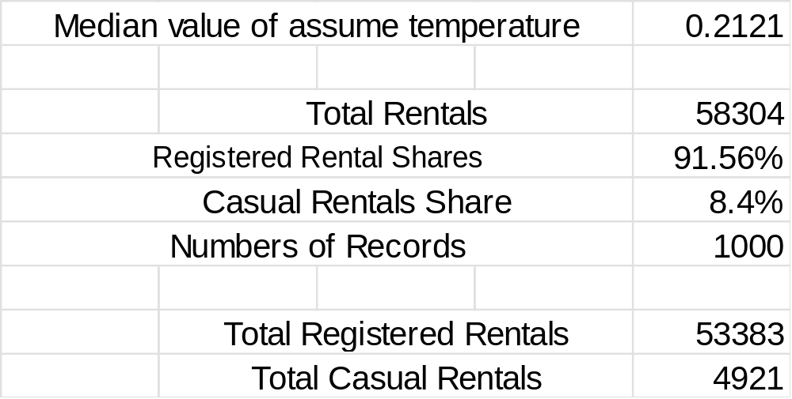
Data Slicer , Preprocessing & KPI
Total Rentals
58304
Registered Rentals Share
91.6%
Casual Rentals Share
8.4%

Slide 6
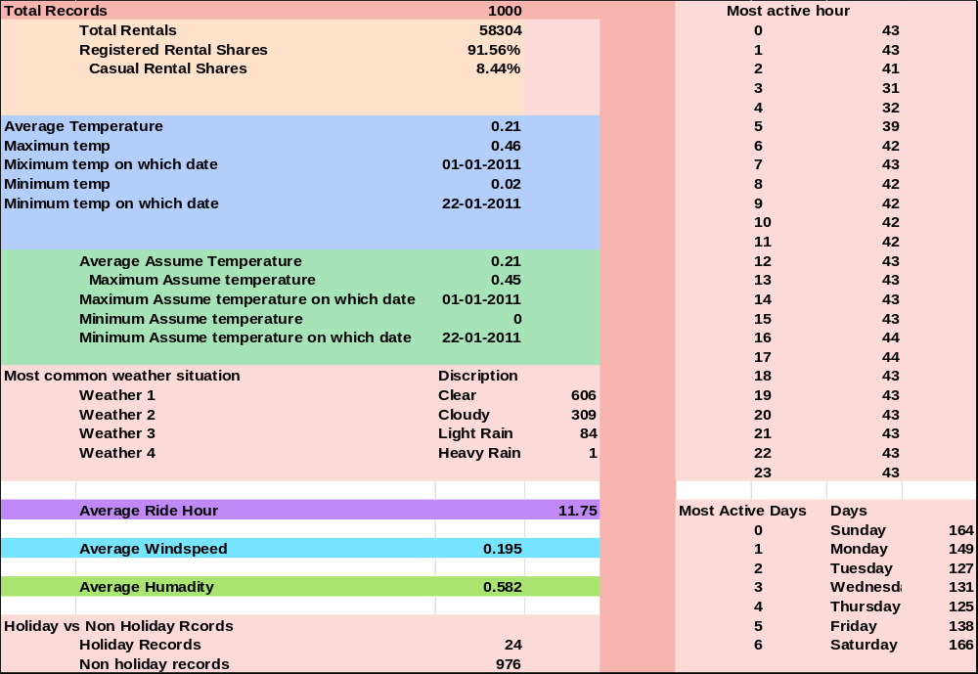
Data Analysis

Slide 7
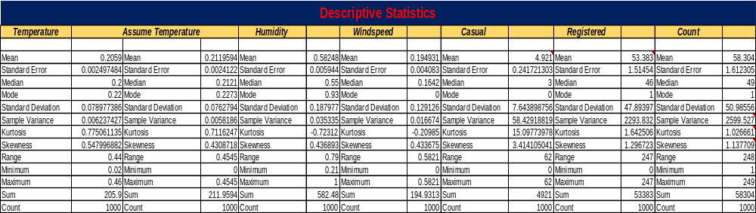
Statistical Analysis
Statistical Measure -- Comment
Mean -- Shows the average number of bike rentals.
Median -- Represents the middle value of bike rentals.
Standard Deviation -- Rental counts show considerable variation around the mean (SD = 2599.527).
Variance -- Indicates high variability in bike rental counts.
Skewness -- Count is positively skewed (1.137709), indicating some days have comparatively high rentals.
Kurtosis -- Count has positive kurtosis (1.026661), suggesting a more peaked distribution with heavier tails than a normal distribution.
Range -- A range of 248 indicates the difference between the highest and lowest values in the analysed data.
Correlation -- Humidity and bike rentals have a weak negative correlation (-0.254353).

Slide 8
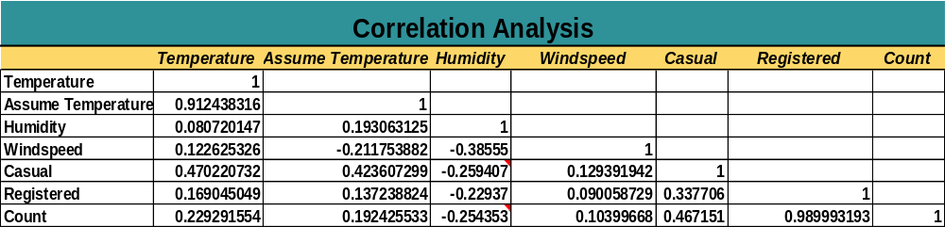
Correlation Analysis
Humidity and bike rentals show a weak negative correlation (-0.254353). This indicates that bike rentals tend to decrease slightly as humidity increases. However, the relationship is weak and does not establish causation.

Slide 9
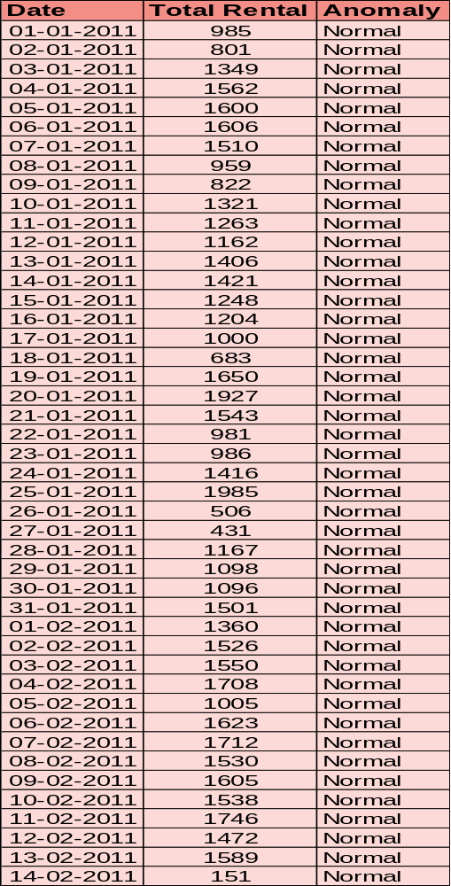
Anomaly Detection
Mean | 1295.644
Std Dev | 392.6486
Upper Bound | 2080.942
Lower Bound | 510.3471
Mean | 58.304
Std Dev | 50.98556
Upper Bound | 160.2751
Lower Bound | -43.6671
High Anomaly | 60
Low Anomaly | 940
Every Days Data Anomaly Detection
Every Hour Data Anomaly Detection
Anomaly Detection helps identify unusual rental demands and investigate possible peak-demand days. All the anomalies shown in the data are normal. This means that these values are not data entry errors; rather they represent errors or genuine demand fluctuations in bike rentals or peak –demand days.

Slide 10
Pivot Table Analysis
Highest Average Hour – 17:00
Next Highest Hour -- 8:00
In clear weather average demand is highest
Highest holiday busiest hour – 13:00
Lowest in – 23:00
Highest Bike Rent on – 20 January & 25 January

Slide 11
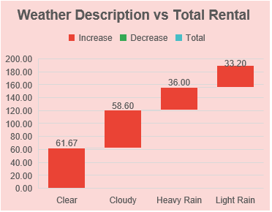
Weather & Forecasting
Clear weather supports demands while rainy condition may affect demands.
Charts indicate negative relationship between windspeed & total rentals.
Whenever temperature is very low or high ,demands are decreases.
The Forecast suggest the possible future trends in bike rentals based on historical data. Actual demand may vary depending on weather and other factors.

Slide 12
Key Findings
The demand is time patterned -- Maintain lots of bikes in peak hour due to high demands
Register riders demand too high – maintain staff and important kit for them
In holidays demand -- in weekdays create a stronger base
Weathers always matters -- adverse weather decrease demand so prepare for some risk
Analytics can move beyond reporting – Anomaly Detection and forecasting turn the dashboard into a planning tool

Slide 13
Conclusion
* The Bike Sharing Data analysis project provides valuable insights into rental trends, weather conditions, and customer behaviour
The analysis shows that registered riders contributes the majority of bike rentals .
Clear Weather is the most frequently recorded condition, while rainy condition may affect rental patterns.
Whenever windspeed increases this may adversely affect rental patterns.
Bike rental demands is higher within a moderate temperature range.
Saturday has the highest rental count in the displayed day-wise summary. Etc.
* The environmental conditions , holiday and time-based insights can help Bike-Sharing companies improve demand planning, fleet management and customer service.

Slide 14
Thank you

Slide 15


